Slide 1
Maximizing the Number of Annual Memberships
Bike-Share Company
October 2026

Slide 2
Problem :
Solution :
Relation Between casual
and membership Riders
Extract meaning full insights to design a new marketing strategy to convert casual riders into annual members.

Slide 3
Analytical goals
Why: Day to Day Impact on Riders
How: Identify Riders Need

Slide 4
Analytical goals
Why: Day to Day Impact on Riders
How: Identify Riders Need

Slide 5
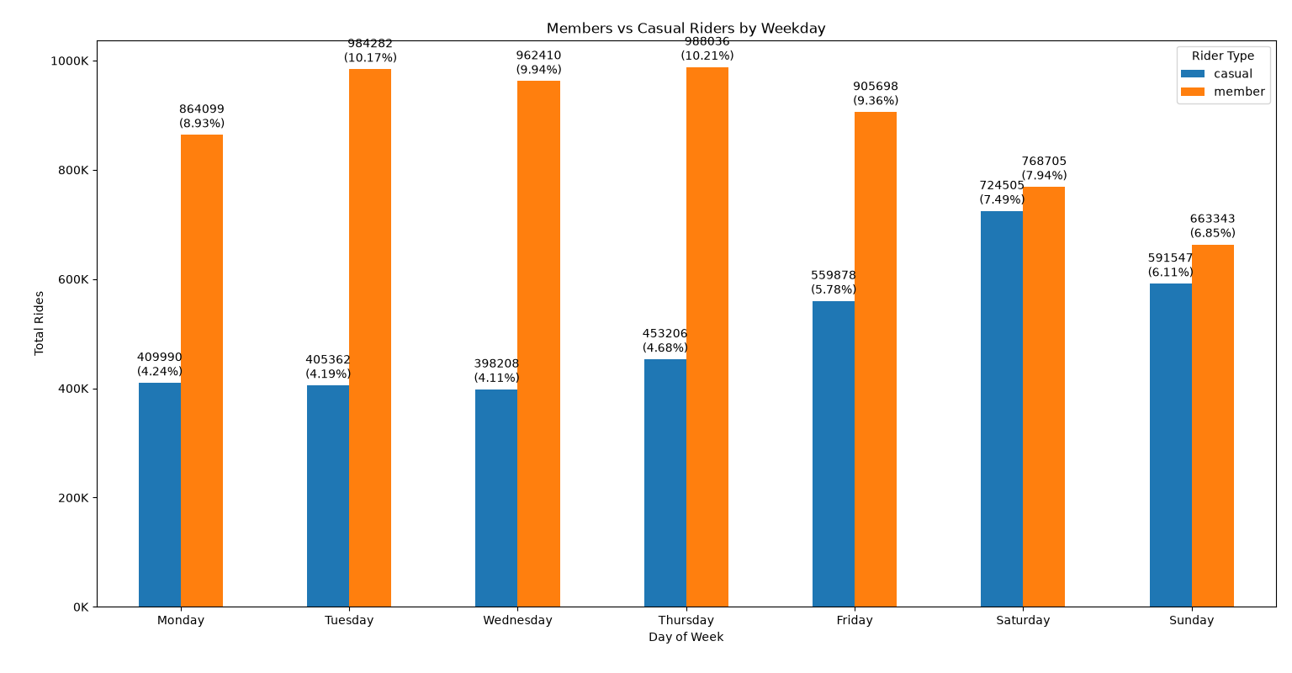
Weekly Rides behavior :
The Difference Between Casual and members Rides is decrease in Weekends as compare to Weekdays.

Slide 6
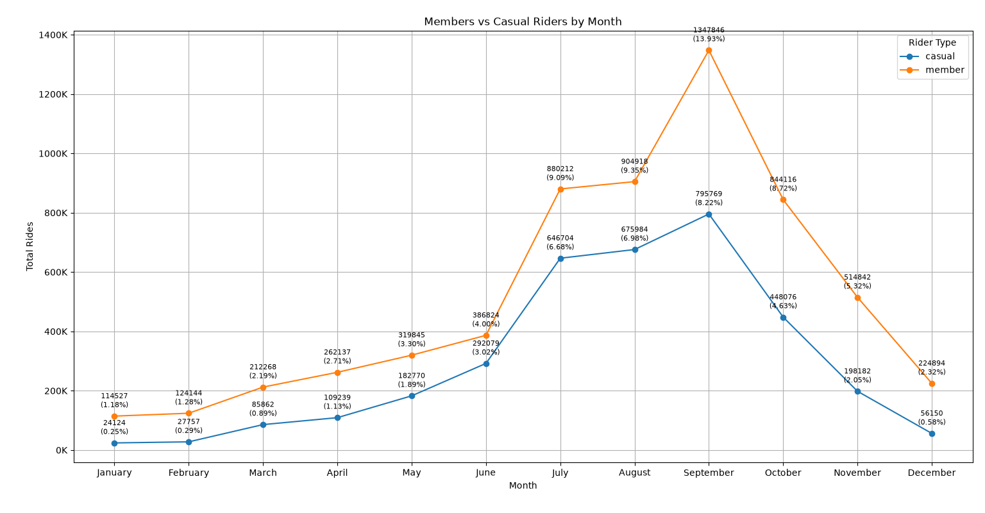
Upward trend:
Member rides are goes to upward after June month and it goes in September at its peak after September it goes downward.

Slide 7
Thus, we need to Increase membership rides to improve rides performance,
Weekly chart shows membership Riders are mostly office workers.

Slide 8
Analytical goals
Why: Day to Day Impact on Riders
How: Identify Riders Need

Slide 9
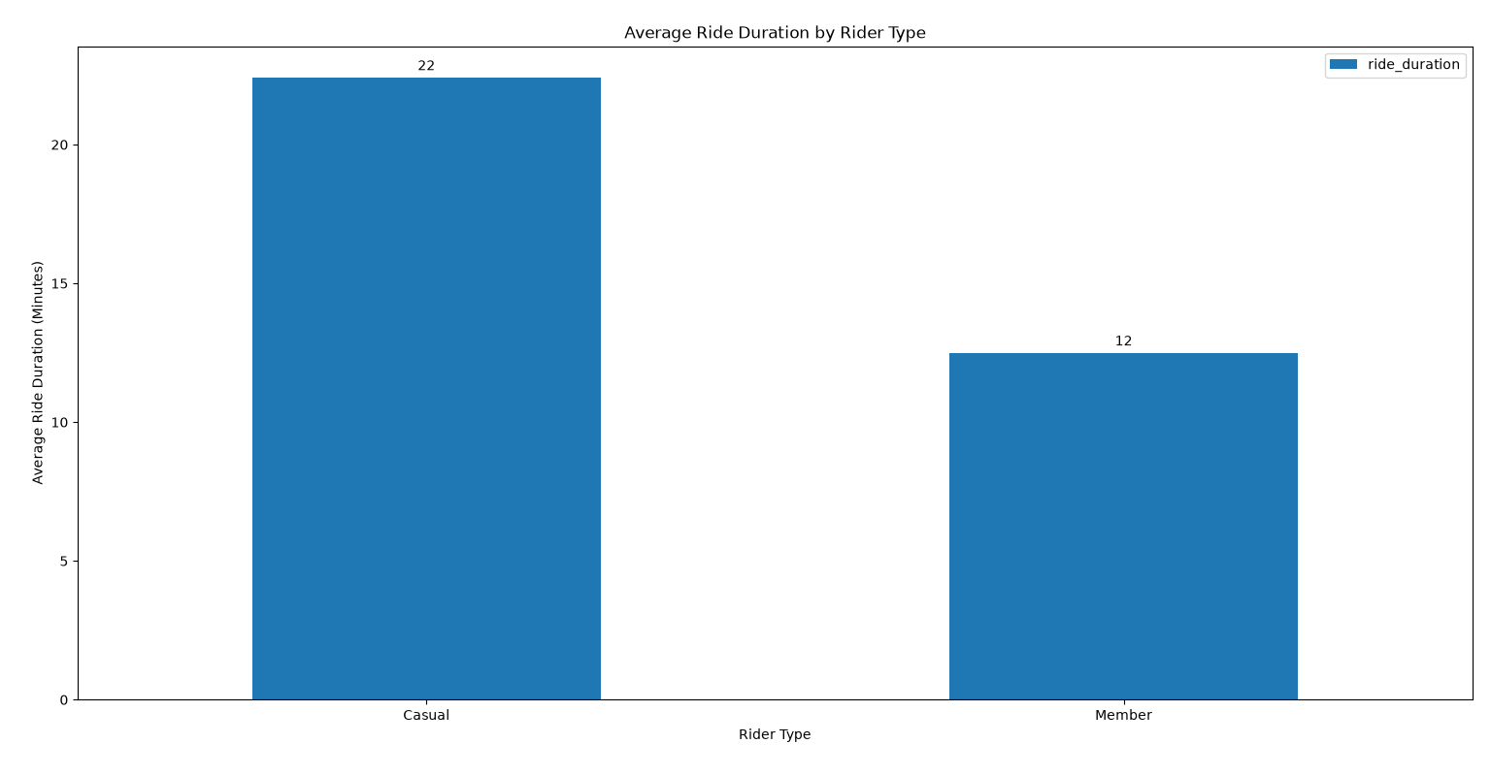
Average ride time duration :
The casual riders average ride duration is higher than member it means casual riders are use rides mostly for long trips
So, we need to add some limitations on casual rides.

Slide 10
Thus, we need to target mostly office workers and add some limitations on casual riders

Slide 11
In Summary :
Why : we need to Increase membership rides to improve rides performance,
Weekly chart shows membership Riders are mostly office workers.
How : we need to target mostly office workers and add some limitations on
casual riders.

Slide 12
Thank You

